Slide 1
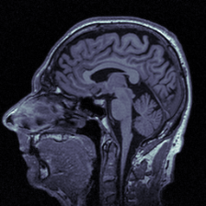
Augmenting and Ensembling to increase the accuracy of Alzheimer’s Disease MRI Classification
Capstone
Spring 2022
Kristin Levine

Slide 2
Four Categories
Use CNN model to classify brain MRIs by their clinical diagnosis
Non-Impaired (Cognitively Normal)
Very Mild Impairment
Mild Impairment
Moderate Impairment

Slide 3
Why this problem:
Prevalence of Alzheimer’s Disease in the US
Big Problem – approximately 6.5 millions Americans
No treatment
Humans aren’t that great at this task
Even trained neurologists get it wrong a lot of the time
One study – Radiologists accuracy of 57.5 and 70%; SVM model was 90.5%
Good medical access and care for everyone
In DC, we have lots of doctors and specialists
In rural areas, lack of radiologists or neurologists to accurately read the MRI

Slide 4
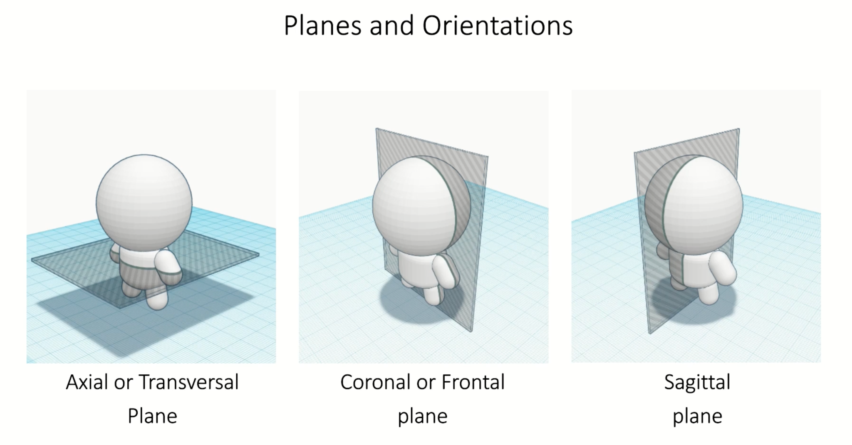
MRI – 3 dimensions
From Udemy: Deep Learning with PyTorch for Medical Image Analysis
class

Slide 5
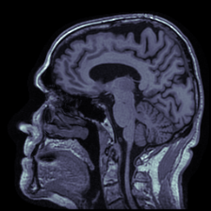
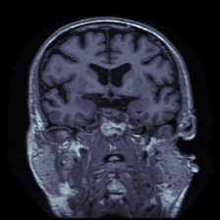
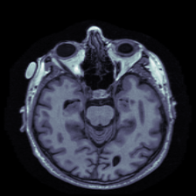
MRI – 3 dimensions
Slices in different directions
Sagittal View
Coronal View
Axial View

Slide 6
About MRI images
Magnetic resonance imaging (MRI) non-invasive produces 3D images of parts of the body
Dementia research – mainly used to take measurements of certain regions of the brain
Differences between machines/people move
CNN to literally just LOOK at the images

Slide 7
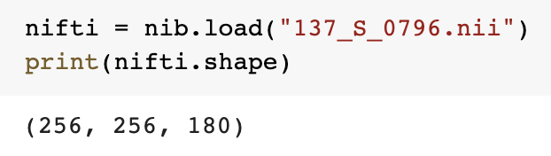
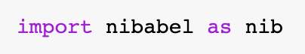
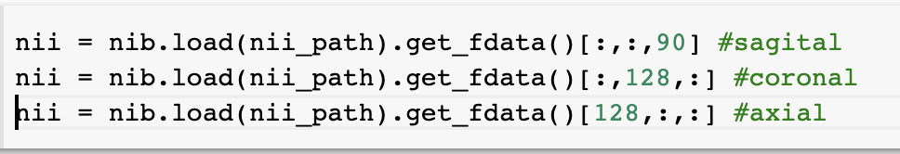
Files types/how to load
Two main types: DICOM and NiFTI
Package called nibabel

Slide 8
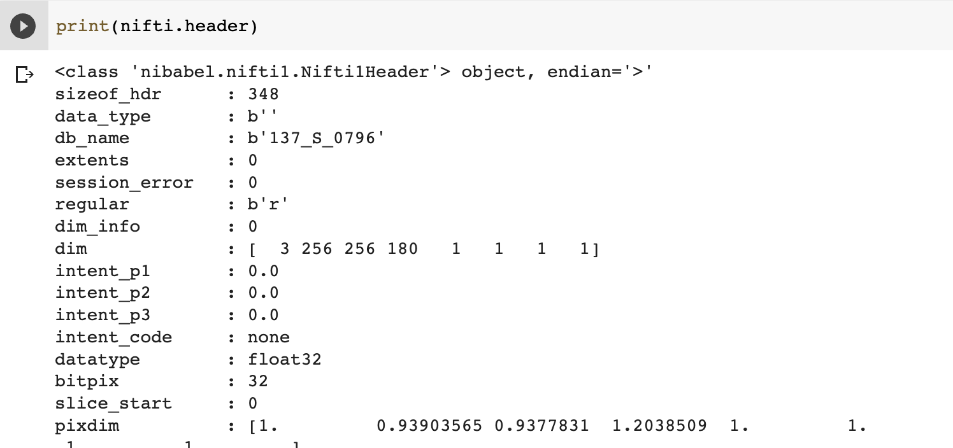
Files types/how to load

Slide 9
Previous studies/concerns:
Many previous studies binary – AD vs CN
May to too late to treat once have full-blown AD
Being able to identify MCI stage very useful
Accuracy of labels
People CAN move from one category to the other
Most often from CN to MCI, or MCI to AD, but sometimes MCI to CN
Mislabel – or predicting future outcome
Lack of data
Not that many correctly labeled images
Multiple slices from each person

Slide 10
Data leakage:
ADNI1 – 3 year follow up – 2182 MRIs
Take 50 slices from each one — 109,100 images
Divide train/val/test
Images from the same person may be in train AND test
May be very very similar
Test set may contain images model has already seen
Divide 2182 images – train/val/test
Still have a problem
People came back for more than 1 visit
Again, have the same person in the train/test groups

Slide 11
Questions:
Does augmentation of images help improve models? If so, what types help the most?
Is that particular pre-trained CNN model that works best?
How much does ensembling improve models?

Slide 12
Data Sources: Kaggle
Website – add photo examples of categories
Train Set | # Images
Non-impaired (cognitively normal) | 2560
Very mild impairment | 1792
Mild impairment | 717
Moderate impairment | 52
Test Set | # Images
Non-impaired (cognitively normal) | 640
Very mild impairment | 448
Mild impairment | 179
Moderate impairment | 12

Slide 13
Models used
ResNet50

Slide 14
Models used
VGG16

Slide 15
Models used
Xception

Slide 16
Preprocessing data
Making a validation dataset that does not change

Slide 17
Preprocessing data
Flipping Data

Slide 18
Preprocessing data
Shifting Data

Slide 19
Modeling
3 pretrained CNNs
3 datasets
9 models today
Pick the best of each type of model
Use random forest to combine into the final prediction

Slide 20
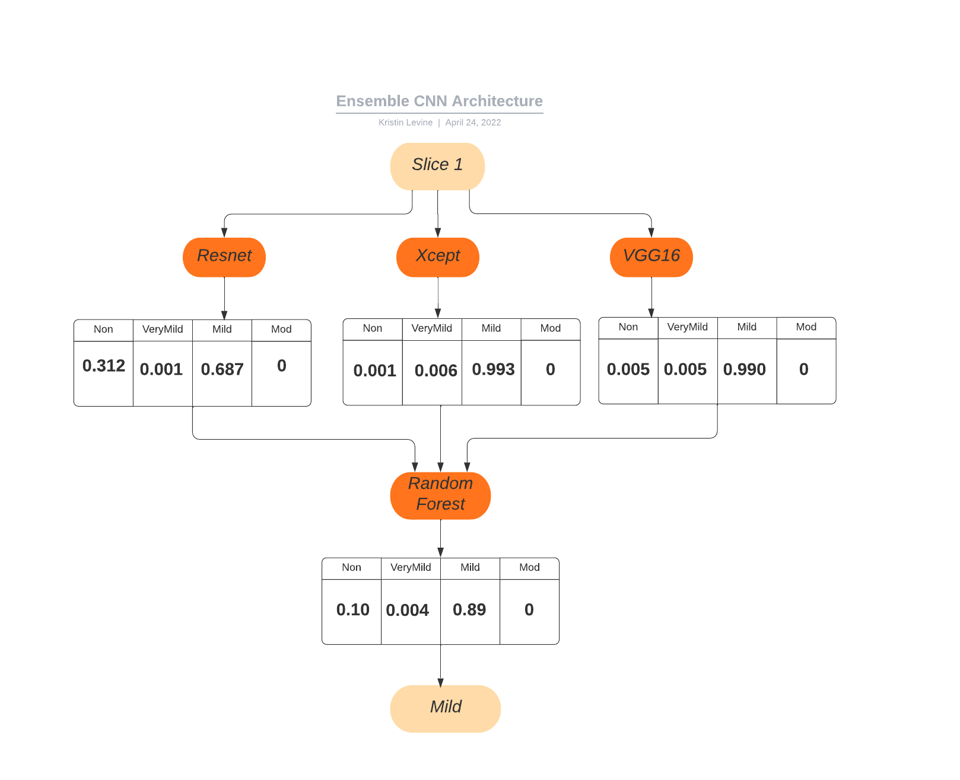
Ensemble CNN Architecture
Website – add photo examples of categories

Slide 21
Individual Model Results
Model | Augmentation | Train Acc | Val Acc | Test Acc
ResNet | None | 1.00 | 0.9740 | 0.7303
VGG16 | None | 0.8597 | 0.8699 | 0.6529
Xception | None | 0.9980 | 0.9453 | 0.6701
ResNet | Flip | 0.9992 | 0.9818 | 0.7224
VGG16 | Flip | 0.9162 | 0.8530 | 0.6482
Xception | Flip | 0.9990 | 0.9655 | 0.7177
ResNet | Shift | 0.9981 | 0.9876 | 0.7482
VGG16* | Shift | 0.9999 | 0.9759 | 0.7240
Xception | Shift | 0.9994 | 0.9681 | 0.7209
Combined |  |  |  | 0.8307
*trained 20 epochs, as I realized this model was taking longer to train

Slide 22
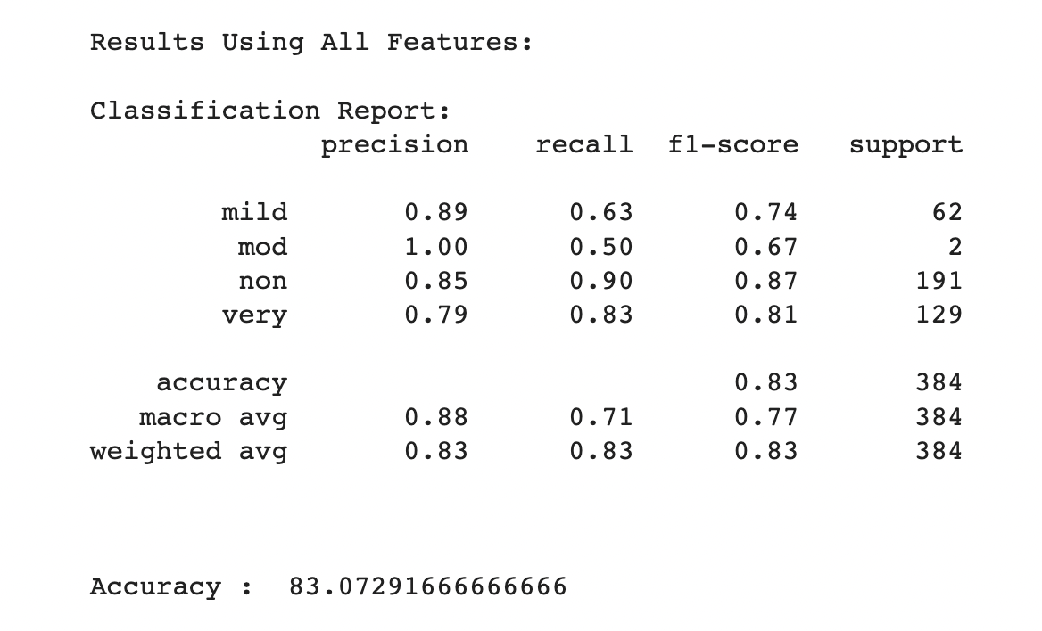
Ensembled Model

Slide 23
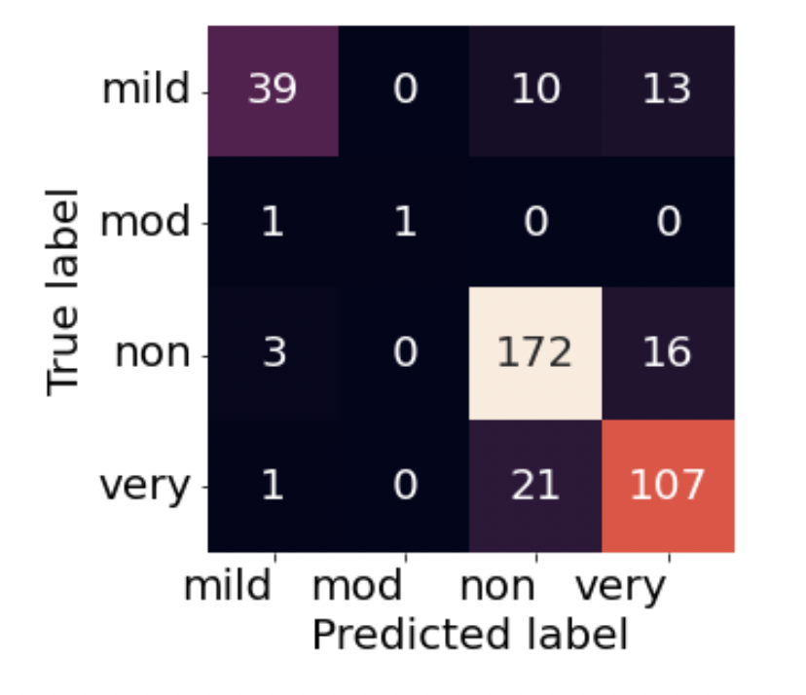
Ensembled Model

Slide 24
Improvement – shifting images
Model | Test Acc (No Aug) | Test Acc (Shifted) | Improvement
ResNet | 0.7303 | 0.7482 | 0.0179
VGG16 | 0.6529 | 0.7240 | 0.0711
Xception | 0.6701 | 0.7209 | 0.0508

Slide 25
Improvement – ensembling
Model | Test Acc (Shifted) | Test Acc (Ensembled) | Improvement
ResNet | 0.7482 | 0.8307 | 0.0825
VGG16 | 0.7240 | 0.8307 | 0.1067
Xception | 0.7209 | 0.8307 | 0.1098

Slide 26
ADNI Attempts

Slide 27
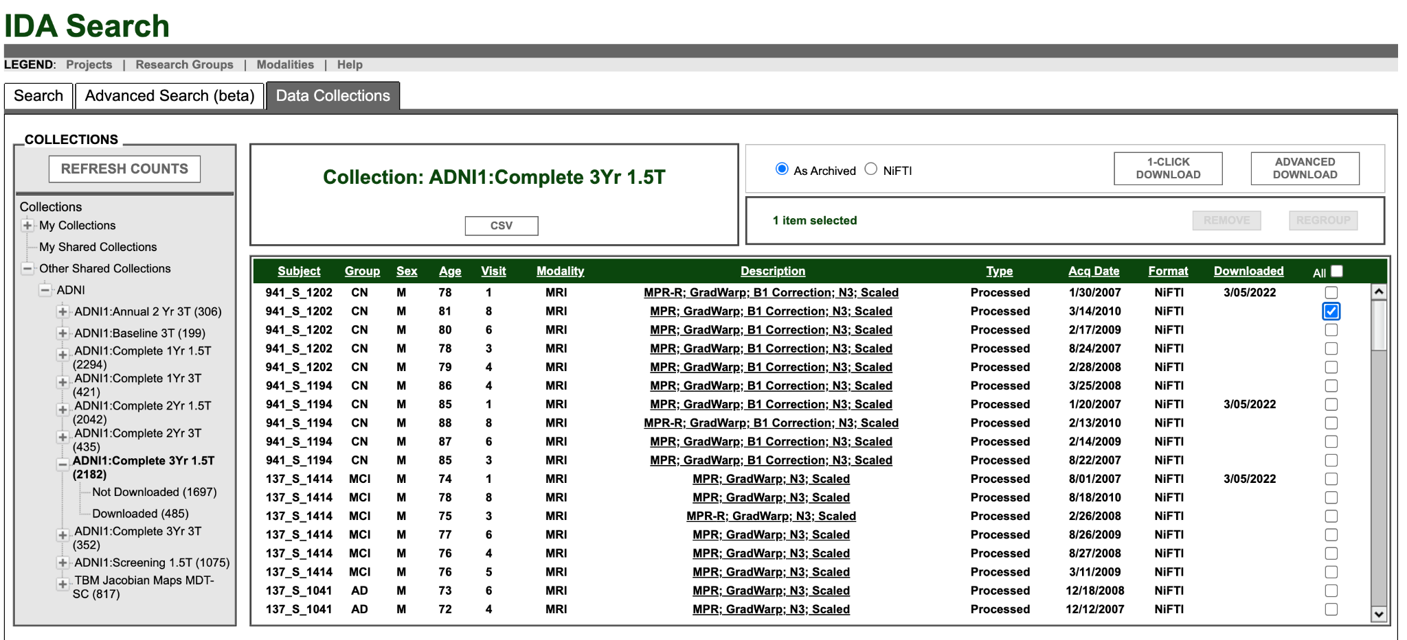
Data Sources: ADNI

Slide 28
Data leakage:
ADNI1 – 3 year follow up – 2182 MRIs
Take 50 slices from each one — 109,100 images
Divide train/val/test
Images from the same person may be in train AND test
May be very very similar
Test set may contain images model has already seen
Divide 2182 images – train/val/test
Still have a problem
People came back for more than 1 visit
Again, have the same person in the train/test groups

Slide 29
Data Sources: ADNI
Alzheimer’s Disease Neuroimaging Initiative
multicenter longitudinal study
clinical, imaging, genetic, and biochemical biomarkers for AD
Started in 2004 as a private-public partnership involving 20 companies and NIH
Most of datasets publicly available online – derived from ADNI
https://adni.loni.usc.edu/

Slide 30
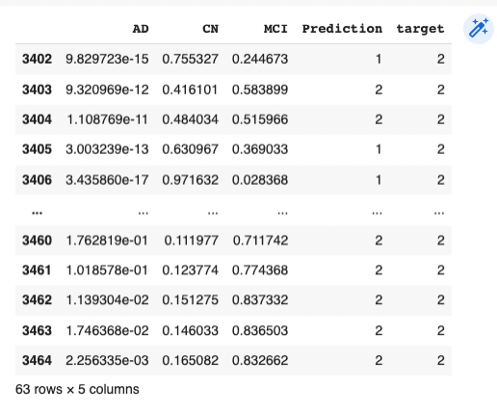
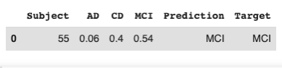
Patient-wise accuracy
Average of all 63 scores – to make final prediction:
Worked for this subject; only at 40% accuracy right now – need to figure out problem

Slide 31
What I’ve done so far
Model | Train Accuracy | Validation Accuracy | Test Accuracy
ResNet | 0.9999 | 0.9982 | 0.4018
Xception | 0.9999 | 0.9977 | 0.3900
VGG16 | 0.9741 | 0.9667 | 0.3993
Basic Keras | 0.9987 | 0.9874 | 0.3353
Still massively fitting to train/validation data
Need to figure out what is going on here

Slide 32
Next steps:
Deal with the overfitting?
What is the optimal number of slices to use? Which slices are the most helpful? Started in the middle, later slices seem to be more helpful
Is there a particular orientation that gives us more info?
Create models using only one orientation?
Website to display results – similar to this:
http://medical-images-testing.s3-website-us-east-1.amazonaws.com/

Slide 33
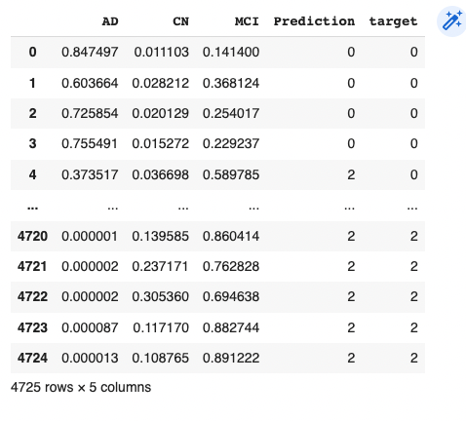
Patient-wise accuracy
AD: 0
CN: 1
MCI: 2
Need to take the slices per patient

Slide 34
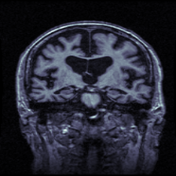
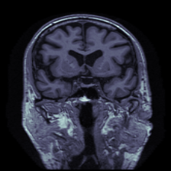
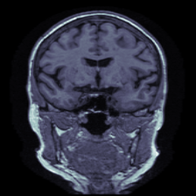
Three Categories
Use CNN model to classify brain MRIs by their clinical diagnosis
Alzheimer’s Disease (AD)
Cognitively Normal (CN)
Mild Cognitive Impairment (MCI)

Slide 35
Data Sources: ADNI
Alzheimer’s Disease Neuroimaging Initiative
multicenter longitudinal study
clinical, imaging, genetic, and biochemical biomarkers for AD
Started in 2004 as a private-public partnership involving 20 companies and NIH
Most of datasets publicly available online – derived from ADNI
https://adni.loni.usc.edu/

Slide 36
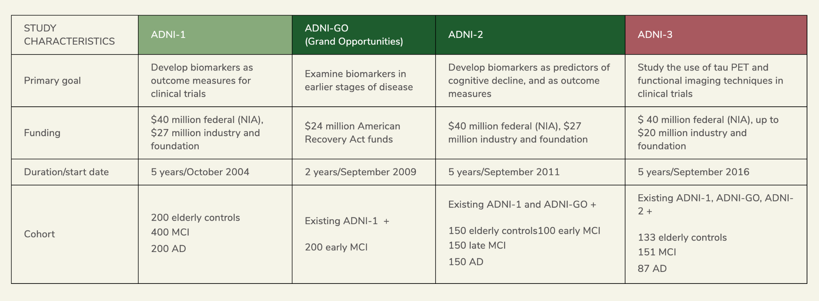
Data Sources: ADNI

Slide 37
Data Used
1 image per person
Split images BEFORE taking slices
Report final answer as per PERSON, not per slice
 | Train/Val | Test
AD | 79 | 20
CN | 108 | 26
MCI | 118 | 29
ADNI
2182
Visit 1
Visit 1
485 MRIs
Duplicates removed
382 MRIs
63 slices per MRI (21 in each orientation)

